Slide 1

Symbiosis Skills and Professional University Kiwale, Pune
Project on Stock Market Analysis
Group Members
Sahil Shaikh
Sahil Tarkash
Shubham Pawar
Rushikesh Kolle
Guide
Prof. R.Singh
Prof. S. Patel

Slide 2
Aim
To develop a user-friendly interface that empowers individuals with the knowledge they need for their first-time investment in the stock market.
We aim to provide an accessible and informative platform to guide new investors in understanding the stock market.
Empower users to make informed decisions and build confidence in their initial stock market investments.

Slide 3
Objective
Develop a robust system for stock data visualization, extraction, and analysis.
Incorporate a wide range of technical indicators for comprehensive market analysis.
Provide user-friendly visualizations and insights for effective decision-making.
To apply scalable data analytics tools and techniques to gain useful insights and to support decision making.

Slide 4
Steps of Stock Analysis Model Working
User Interface:
Users access the platform and write ticker name of the stock in the defined place.
Stock Selection:
Users choose a stock from the list of Yahoo Finance listed stocks.
Date Range Selection:
Users select a start and end date for the analysis, defining the period of interest.

Slide 5
Data Retrieval from Yahoo Finance:
The system fetches detailed data for the selected stock from Yahoo Finance API.
Detailed Stock Information:
Users can view comprehensive details about the selected stock, including but not limited to:
Opening and closing prices.
High and low prices.
Trading volume.
Dividends and stock splits.

Slide 6
Downloadable Reports:
Users have the option to download a detailed report for the selected stock during the chosen date range.
The report may include key metrics, charts, and relevant financial information.
User Interaction:
The interface is designed to be interactive, allowing users to zoom in on specific data points on the charts and explore additional information.
Dynamic Chart Generation:
The system generates dynamic charts to visually represent the stock's performance over the selected date range.
Charts may include line charts, candlestick charts, or other relevant visualizations.

Slide 7

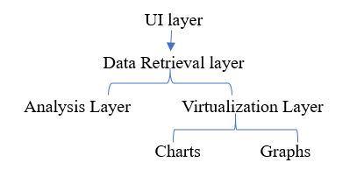

Slide 8
Doman Details
Technology Stack:
Python : Primary programming language for application logic.
Numpy : Used for numerical operations and data manipulation.
Pandas : Essential for data manipulation and analysis.
Matplotlib : Employed for creating interactive and insightful visualizations.
Tkinter : GUI toolkit for building a user-friendly interface.
Y-finance : Python library for fetching data from Yahoo Finance.

Slide 9
User Interface
Intuitive Design: Focus on a clean and user-friendly interface.
Interactive Charts: Utilize Matplotlib for dynamic and informative stock charts.
Date Range Selection: Allow users to easily choose start and end dates for stock analysis.

Slide 10
Data Source
Yahoo Finance: Fetch real-time and historical stock data from Yahoo Finance.
Reliability: Yahoo Finance is a reputable source for accurate and comprehensive financial data.
Functionality:
Stock Selection: Users can choose any stock listed on Yahoo Finance.
Date Range Selection: Define a specific period for stock analysis.
Detailed Information: Provide comprehensive details about the selected stock.
Downloadable Reports: Allow users to download reports for the chosen date range.

Slide 11
Workflow
User Input: Choose stock, select start and end dates.
Data Retrieval: Fetch relevant stock data from Yahoo Finance.
Analysis: Utilize Numpy and Pandas for in-depth analysis.
Visualization: Present findings through interactive charts using Matplotlib.
Downloadable Reports: Generate downloadable reports for user convenience.
Conclusion:
User-Friendly Tool: Developed a platform that prioritizes ease of use for all users.
Empowering Analysis: Provides users with the tools needed for effective stock analysis.

Slide 12
What Do We Want
Empower users to make informed stock market decisions through a user-friendly analysis tool, integrating Python technologies for efficient data retrieval, analysis, and visualization.
our project is to bridge the gap between raw stock market data and actionable insights, enabling users to optimize their investment strategies and maximize returns.

Slide 13
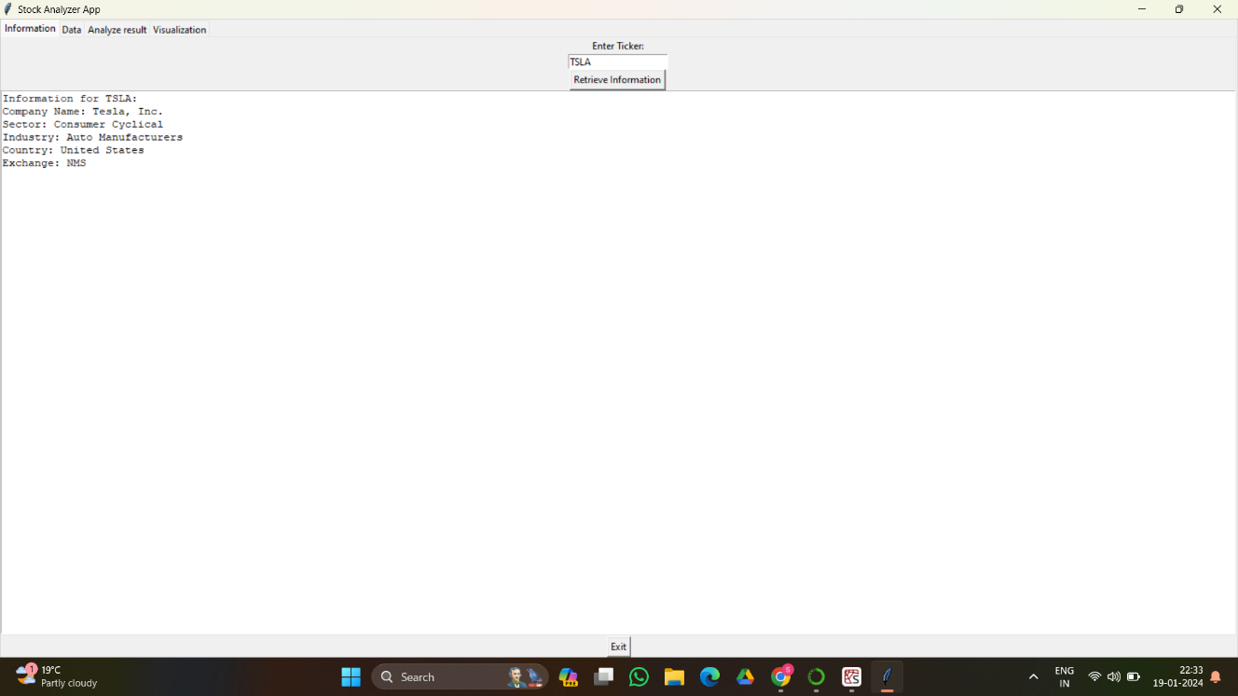
Screen Shorts

Slide 14
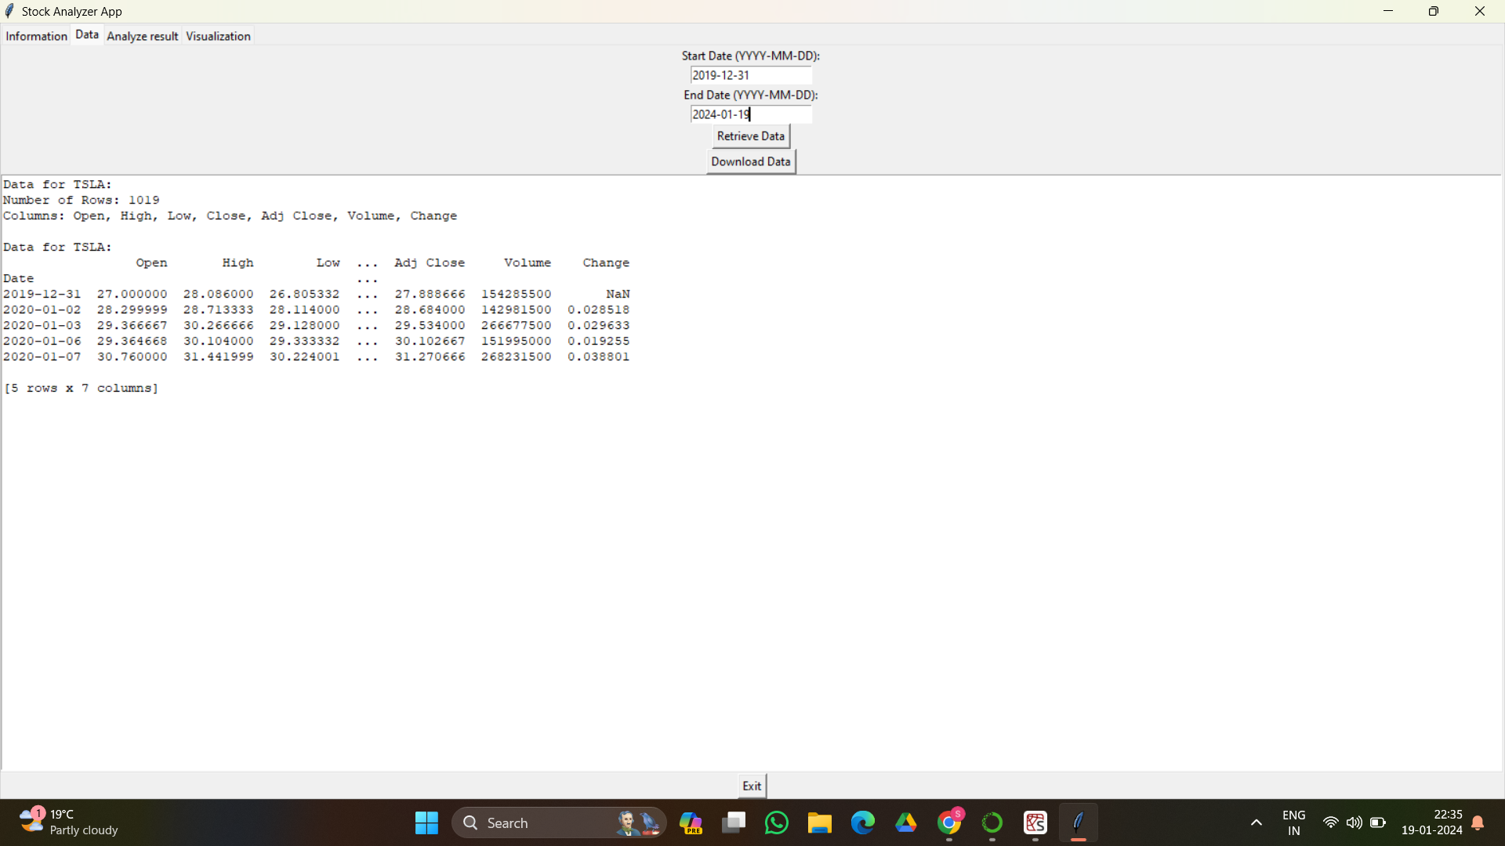

Slide 15
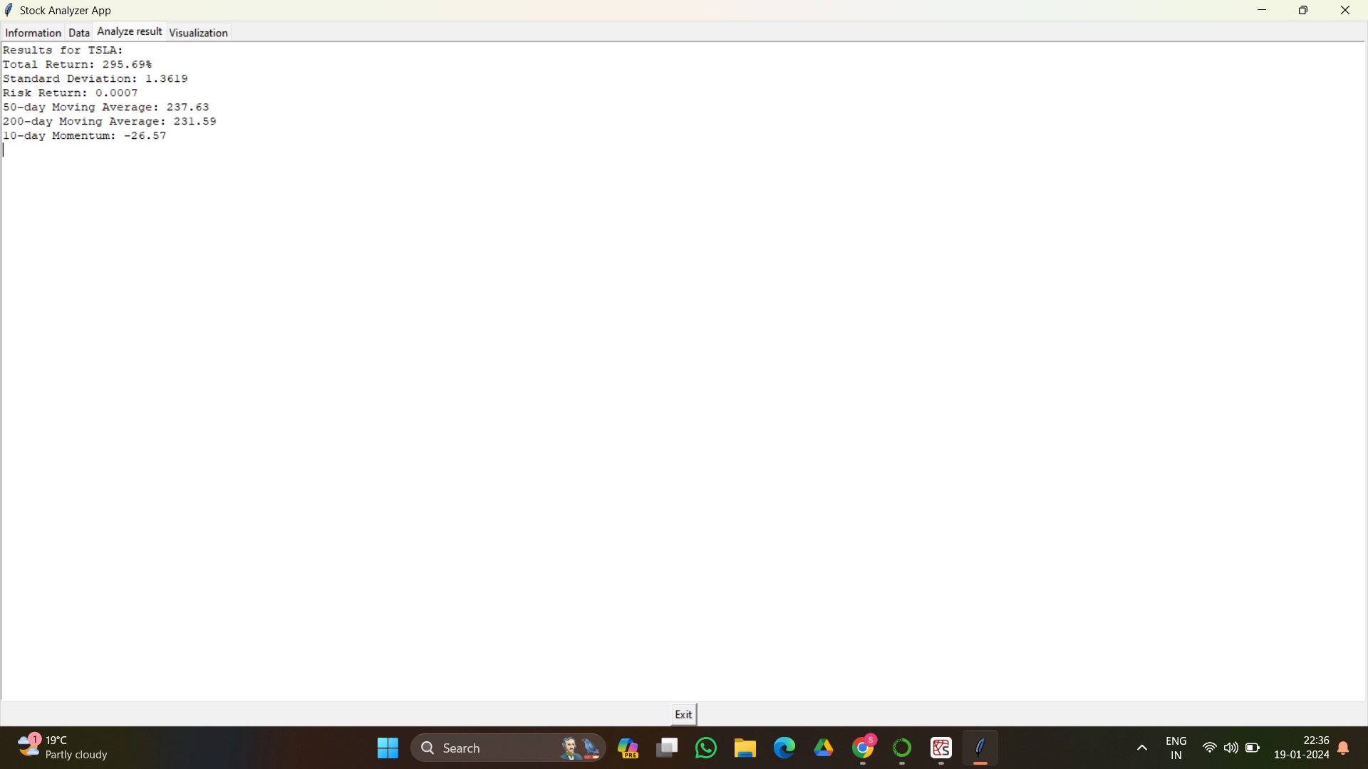

Slide 16
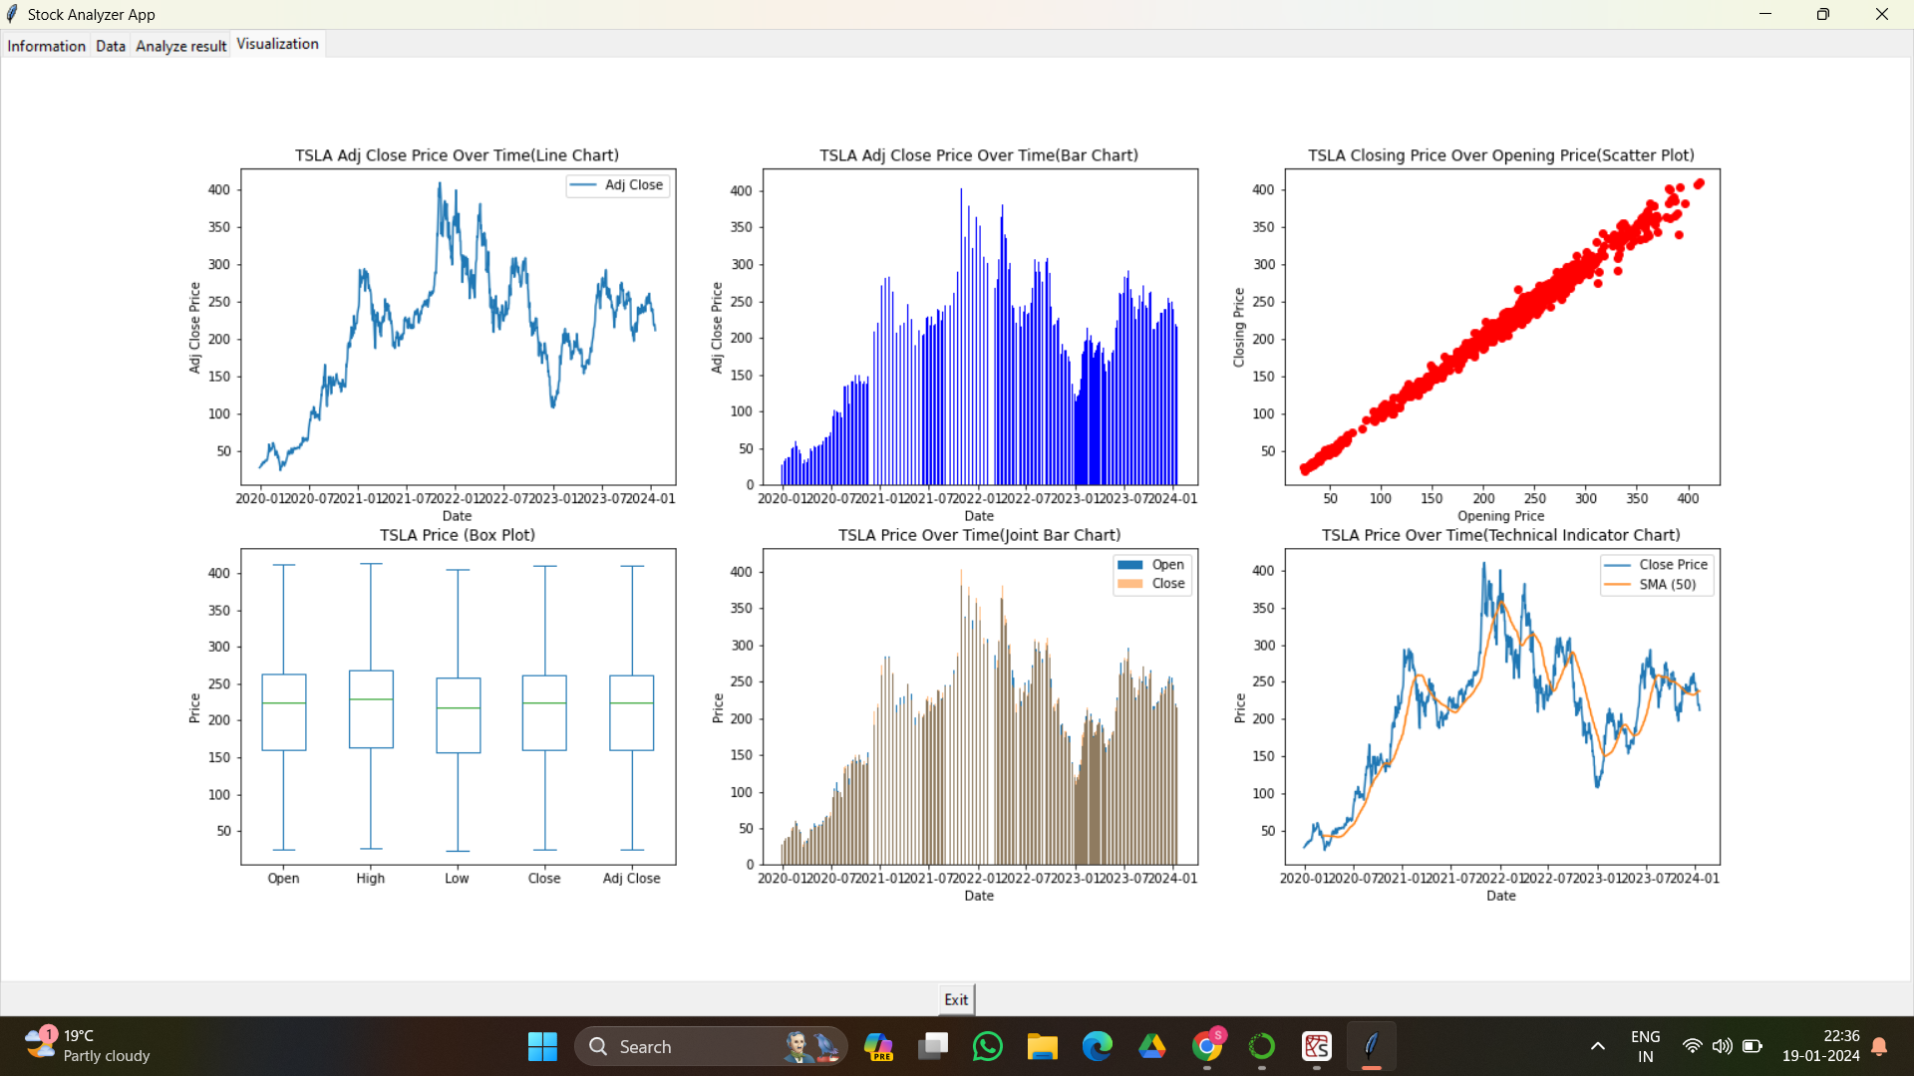

Slide 17
Conclusion
The stock visualization, extraction, and analysis project aim to provide users with a powerful tool for understanding and analyzing stock market data using technical indicators.
Visualizing historical stock data allows users to identify trends, patterns, and potential entry or exit points for trades.
The integration of technical indicators and analysis allows for data-driven decision-making, improved timing, and risk management.

Slide 18
References
[1]Richen Liu;Hailong Wang;Chuyu Zhang;Xiaojian Chen;Lijun Wang;Genlin Ji;Bin Zhao;Zhiwei Mao;Dan Yang; (2021). Narrative Scientific Data Visualization in an Immersive Environment . Bioinformatics, ()doi:10.1093/bioinformatics/btab052.
[2] Waskom, M. L., (2021). seaborn: statistical data visualization. Journal of Open Source Software, 6(60), 3021,https://doi.org/10.21105/joss.03021.
[3] Luo, Yuyu; Qin, Xuedi; Tang, Nan; Li, Guoliang (2018). [IEEE 2018 IEEE 34th International Conference on Data Engineering (ICDE) - Paris, France (2018.4.16-2018.4.19)] 2018 IEEE 34th International Conference on Data Engineering (ICDE) - DeepEye: Towards Automatic Data Visualization. , (), 101–112. doi:10.1109/ICDE.2018.00019.

